Slide 1


Remainder and Unit Digit Session No.: Course Name: Course Code: O1UA422L Instructor Name: Duration: 50 Mins Date of Conduction of Class:

Slide 2

Learning Outcome:
Learning Outcome 1: Apply basic concepts to solve remainder-related problems.
Learning Outcome 2: Predict unit digits in large powers and exponential expressions.

Slide 3
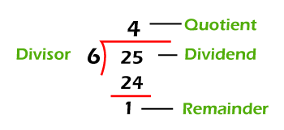
Remainder theorem
Dividend= (Divisor × Quotient + remainder)
If remainder = 0, then the number is perfectly divisible by divisor and divisor is a factor of the number.

Slide 4
Question: In a division process the divisor is 5 times of the quotient and the remainder is 3 times of the quotient. If the remainder is 15, find the dividend.
[A] 140
[B] 150
[C] 170
[D] 190
Notes:
Answer: A
‹#›

Slide 5
Question: When a number is divided by 102 leaves 87 as remainder. If the same number is divided by 17, find the remainder.
[A] 1
[B] 5
[C] 7
[D] 2
Notes:
Answer: D
‹#›

Slide 6
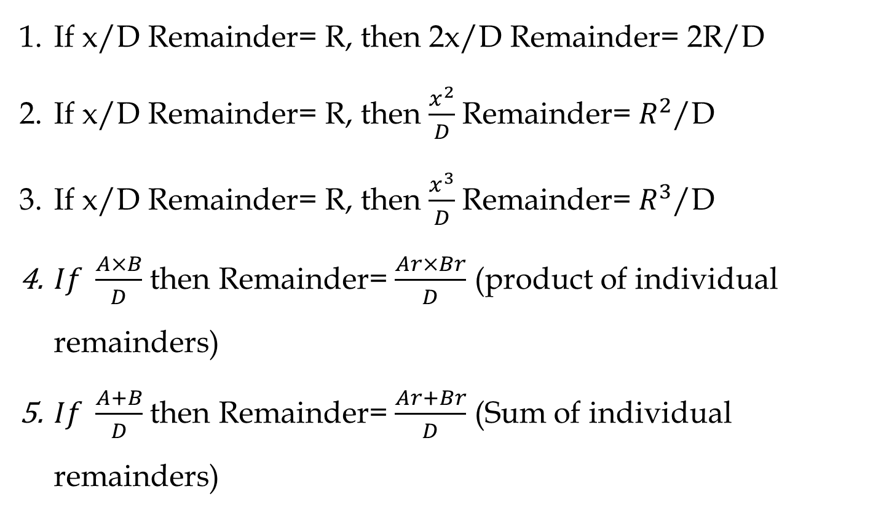
Important Rules

Slide 7
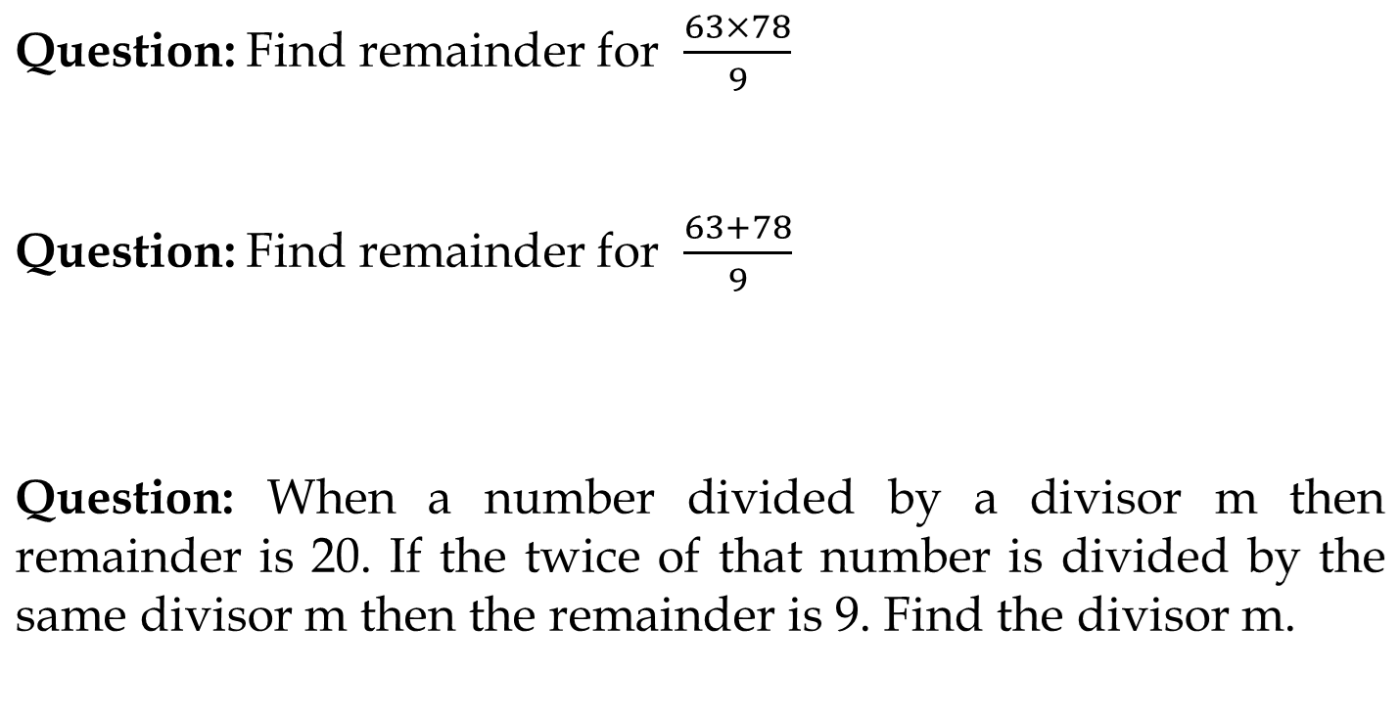
Notes:
Answer: 0, 6, 31
Answer: 8
Answer: 31
‹#›

Slide 8
Question: Find the remainder when 73 × 75 × 78 × 57 × 197 × 37 is divided by 34.
A. 32
B. 30
C. 15
D. 28
Notes:
Answer:A
‹#›

Slide 9
Question: Find the remainder when 73 + 75 + 78 + 57 + 197 is divided by 34.
A. 32
B. 4
C. 15
D. 28
Notes:
Answer: B
‹#›

Slide 10
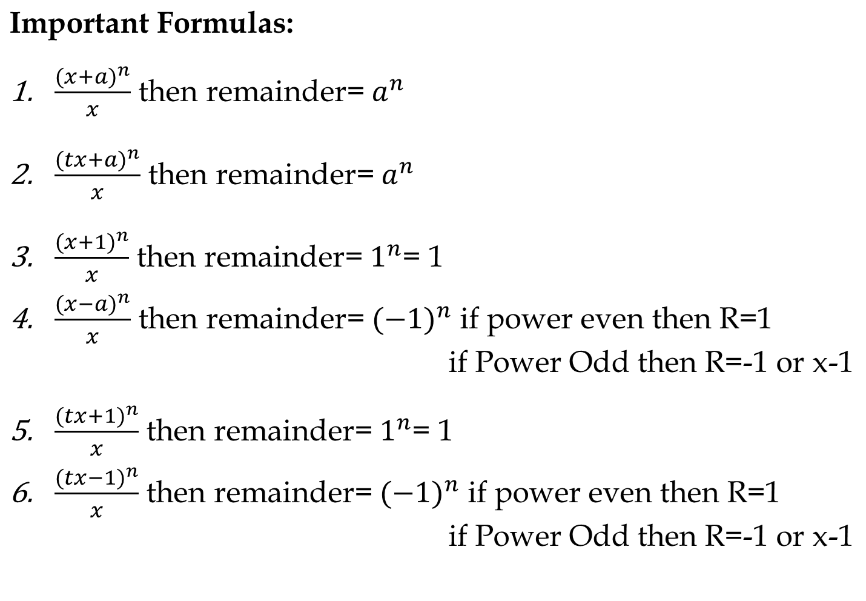

Slide 11
Remainder Cyclicity:
Example: What is the remainder when 2^202 is divided by 7?
2^1/7 = R(2)
2^2/7= R(4)
2^3/7 = R(1)
The next three remainder values will be the same. i.e., The remainder pattern is 2,4,1, 2,4,1, 2,4,1.....The size of the pattern is 3.
Now divide the power by number of repeating values (3) to choose the remainder.
Choose the nth value in the cycle if the remainder is n except for the last value whose remainder should be 0.
202/3 = R(1).
The 1st value in the cycle is 2.
Note: While finding the remainder pattern if the remainder becomes 1, then the process can be stopped as the it will always repeat after 1.
∴ 2^202/7 = R(2)

Slide 12
Note: Do not cancel any numerator value with the denominator value as the remainder will differ.
R(6/4) ≠ R(3/2)
6/4 = R(2)
But 3/2 = R(1)
If you want to cancel out numerator and denominator by a certain value then at last we also need to multiply the remainder by the same value in order to get correct remainder.

Slide 13
Question: What is the remainder when 3^7 is divided by 8?
[A] 3
[B] 4
[C] 5
[D] 7
Notes:
Answer: A
‹#›

Slide 14
Question: Remainder when 17^23 is divided by 16?
[A] 1
[B] 2
[C] 3
[D] 4
Notes:
Answer: A
‹#›

Slide 15
Question: Remainder when 35^113 is divided by 9?
[A] 1
[B] 8
[C] 3
[D] 4
Notes:
Answer: B
‹#›

Slide 16
Question: Remainder when 2^33 is divided by 9?
[A] 1
[B] 4
[C] 8
[D] 5
Notes:
Answer: C
‹#›

Slide 17
Question: Remainder when 2^99 is divided by 10?
[A] 1
[B] 4
[C] 2
[D] 8
Notes:
Answer: D
‹#›

Slide 18
Question: Remainder when 5^500 is divided by 500?
[A] 125
[B] 1
[C] 5
[D] 250
Notes:
Answer: A
‹#›

Slide 19
Questions: What is the remainder when 1! +2! +3! +-----------------------100! Is divided by 60?
(a) 30
(b) 33
(c) 3
(d) 63
Notes:
Answer : b
‹#›

Slide 20
Important Rules
(a^{n} + b^{n}) is divisible by (a + b), when n is odd.
(a^{n} - b^{n}) is divisible by (a + b), when n is even.
(a^{n} - b^{n}) is always divisible by (a - b), for every n.
Wilson’s Theorem-
This theorem states that for a prime number p , (p-1)! Divided by p , then the remainder is p-1.

Slide 21
Question: What is the remainder when we divide 3⁹⁰ + 5⁹⁰ by 34?
7
2
6
0
Notes:
Answer: D
‹#›

Slide 22
Question: Find the remainder when 16! is divided by 17.
A. 16
B. 17
C. 18
D. 15
Notes:
Answer: A
‹#›

Slide 23
Unit Digit Concept
The rightmost digit of a number is called its Unit digit.
For e.g. 278 × 623 what will be the unit digit?
Notes:
4

Slide 24
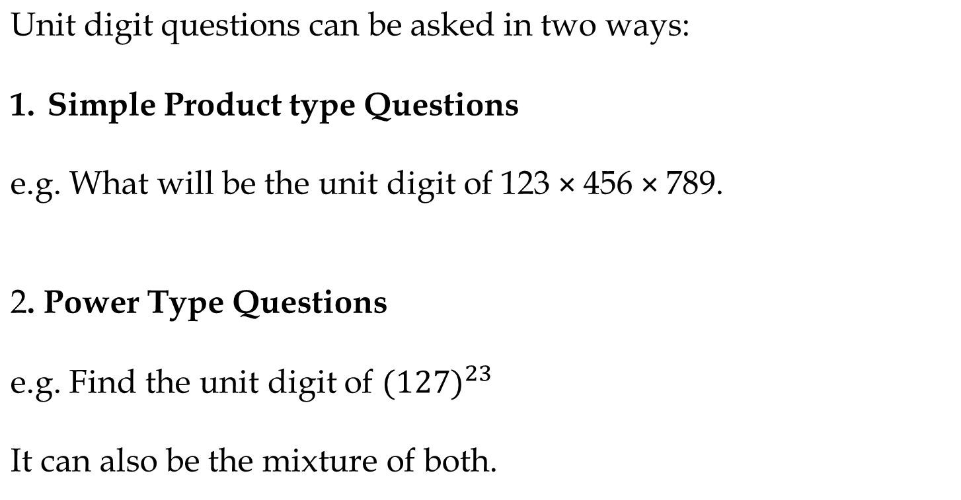
Notes:
2, 3

Slide 25
We can put digits into three categories:
Numbers ending with (0, 1, 5, 6)
Numbers ending with (4,9)
Numbers ending with (2,3,7,8)
Each category follow a certain rule.

Slide 26
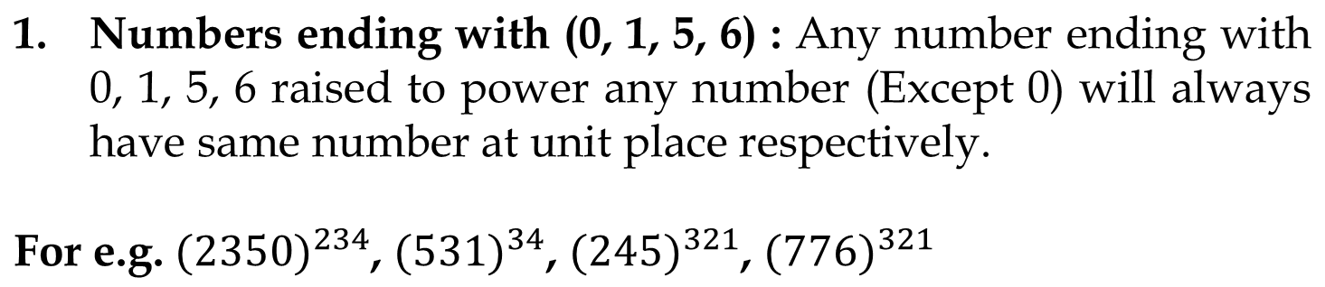

Slide 27
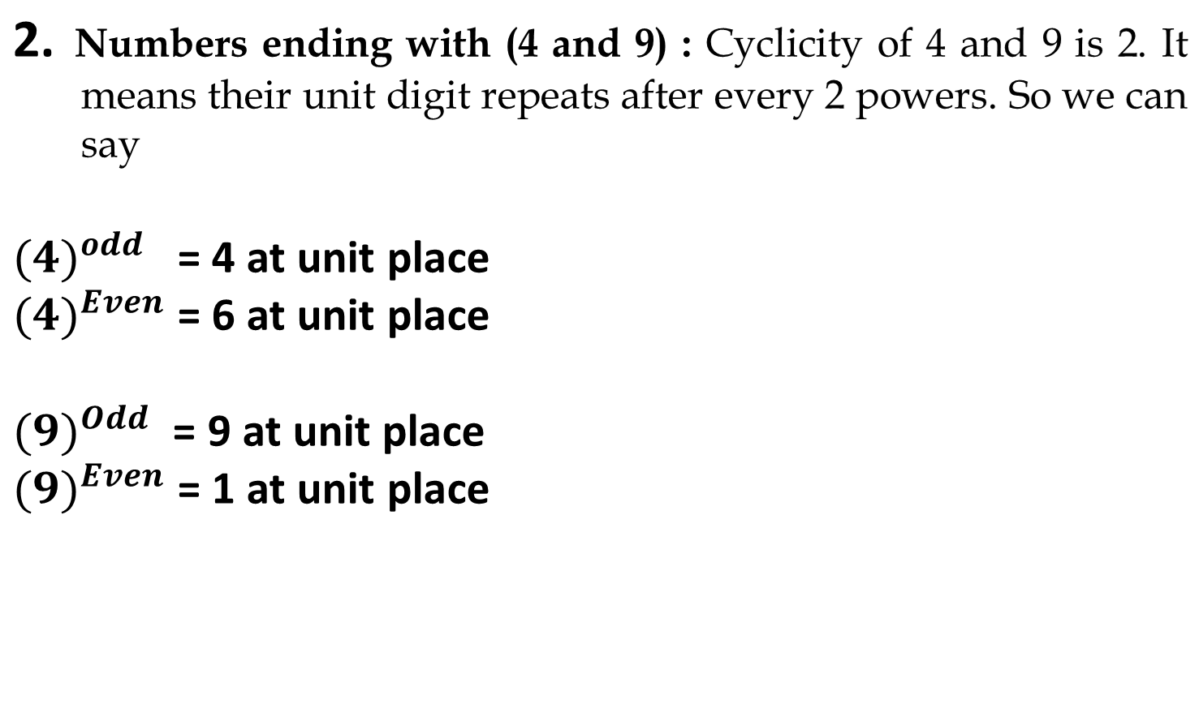

Slide 28
3. Numbers ending with (2,3,7,8) : All numbers have cyclicity of 4, it means after every 4th power, the unit digit pattern will be same.
In these type of questions, we will divide the power by cyclicity (i.e. 4) so that we will know how many cycles have been completed and we will try to find remainder. And unit digit will be (2,3,7,8)^Rem
Note: If remainder is zero then we take highest power of that cycle which is 4. or we can say (2,3,7,8)^4

Slide 29
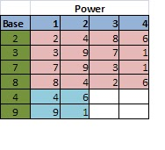
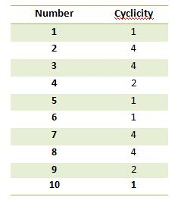
Choose the nth value in the cycle if the remainder is n except for the last value whose remainder should be 0.

Slide 30
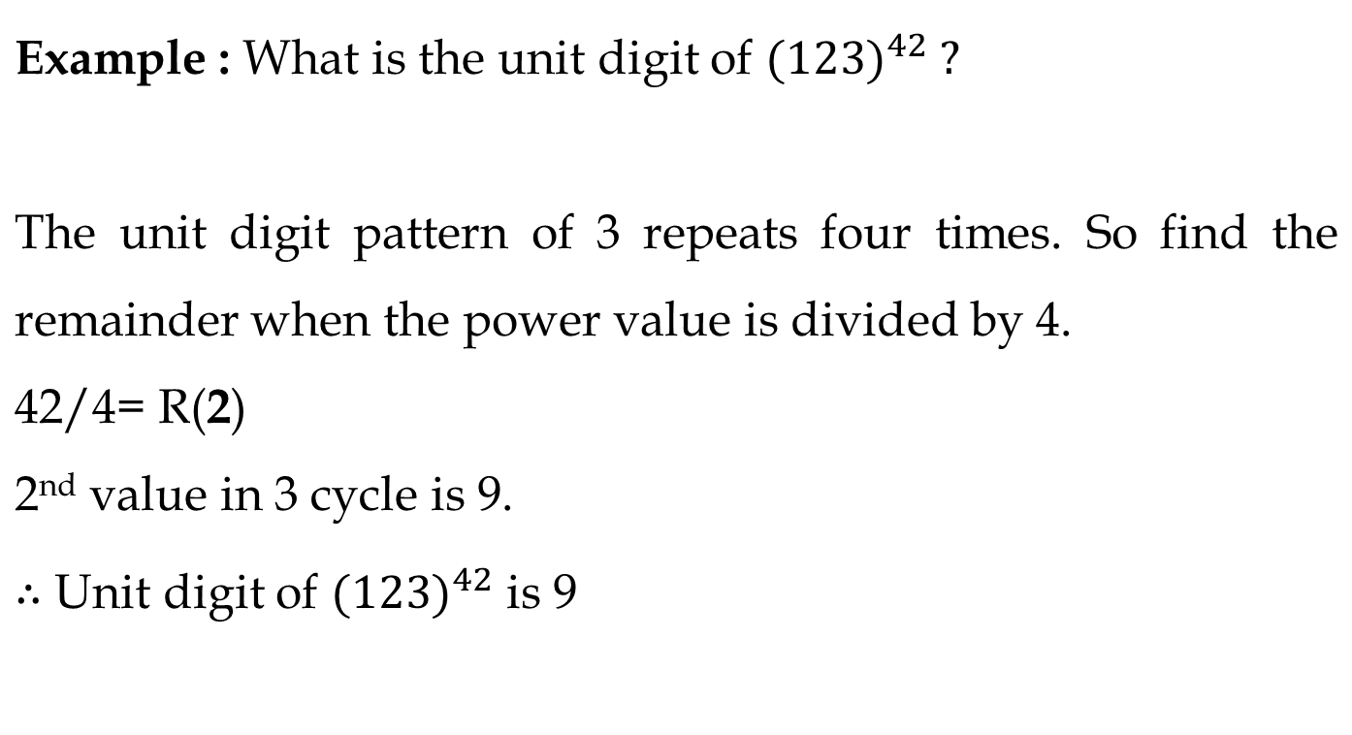

Slide 31
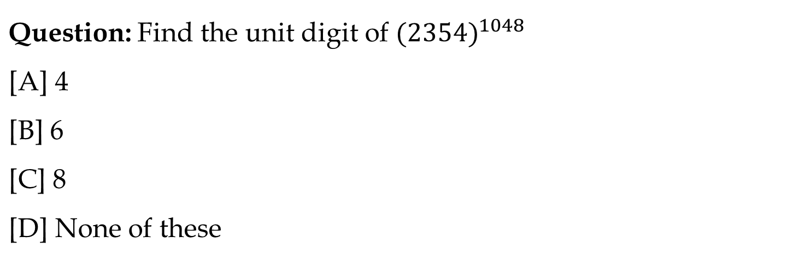
Notes:
Answer: A
‹#›

Slide 32
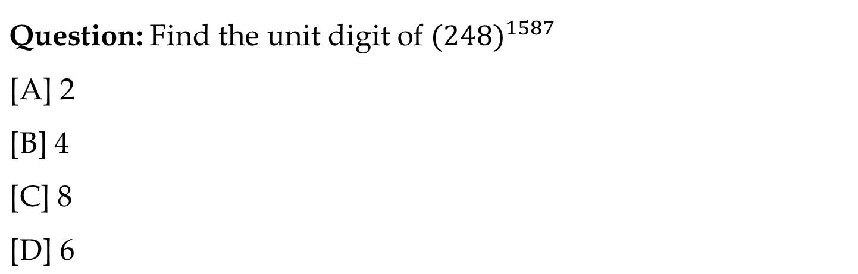
Notes:
Answer: C
‹#›

Slide 33
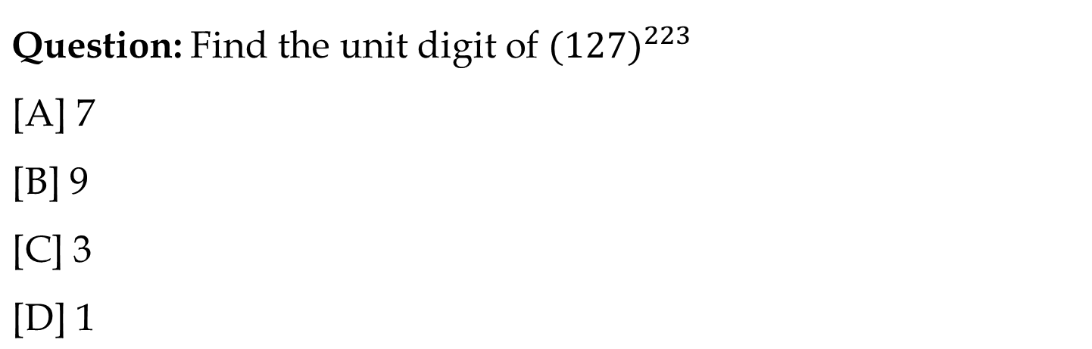
Notes:
Answer: C
‹#›

Slide 34
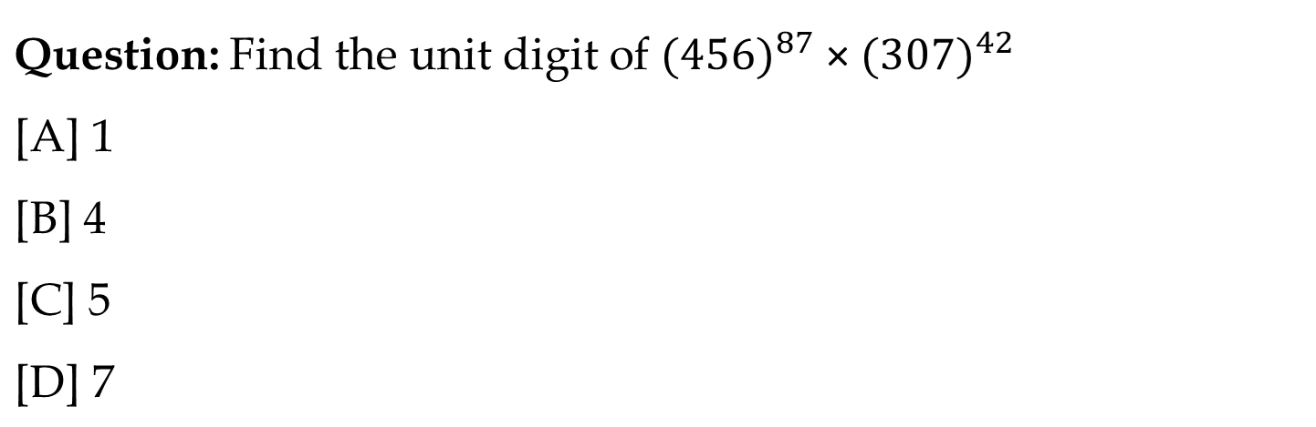
Notes:
Answer: C
‹#›

Slide 35
Questions: What is the units digit in (7⁹⁵ - 3⁵⁸) ?
0
4
6
7
Notes:
Answer: B
‹#›

Slide 36
Questions: What is the units digit of (6374)¹⁷⁹³ x (625)³¹⁷ x (341)⁴⁹¹ ?
0
2
3
5
Notes:
Answer: A
‹#›

Slide 37
Ensure attainment of LOs in alignment to the learning activities: outcomes (1-2)
Outcome 1: Students are able to solve remainder problems using basic concepts.
Outcome 2: Students can apply remainder and unit digit concepts in competitive exam questions.

Slide 38
Information about the next lesson

Slide 39
Review and Reflection from students

Slide 40

THANK YOU

